Slide 1
Model Governance
Ensuring Trust, Compliance, and Control in ML Systems

Slide 2
What and Why of Model Governance
What is Model Governance?
Framework to manage, monitor, and control ML models throughout their lifecycle.
Ensures transparency, accountability, and compliance.
Includes documentation, auditability, reproducibility, and ethical use.
Why Model Governance is Important
Regulatory Compliance: e.g., GDPR, HIPAA, Fair Lending laws
Trust & Accountability: Build confidence among stakeholders
Risk Mitigation: Detect bias, data leakage, and model failures
Reproducibility: Track lineage, metadata, and model versions

Slide 3
Core Pillars of Model Governance
Pillar | Description
Model Lineage | Track data, code, and configuration of each model
Auditability | Maintain logs of decisions, changes, approvals
Compliance | Align with regulations and internal policies
Explainability | Ensure models can be interpreted and explained
Access Control | Secure access to models and sensitive data

Slide 4
Model Lifecycle Governance Stages
Stage | Governance Focus
Development | Code quality, reproducibility, version control, documentation
Validation | Bias checks, fairness audit, performance benchmarking
Deployment | Approval workflow, CI/CD traceability, access control
Monitoring | Performance drift, data drift, usage tracking, alerts
Retraining | Triggering policy, dataset refresh, audit retrain events, version update
Retirement | Deprecation plan, archive models, maintain compliance logs

Slide 5
Governance Artifacts to Maintain and the Helpful tools
Governance Artifacts to Maintain
Model Card (e.g., author, use case, limitations)
Data Lineage Logs (source, transformations)
Experiment Metadata (metrics, hyperparameters)
Approval Workflows & Sign-offs
Risk & Bias Reports
Tools & Frameworks for Governance
Tracking: MLflow, DVC, Weights & Biases
Audit & Security: Azure ML Governance, SageMaker Model Registry
Bias/Explainability: SHAP, LIME, IBM AI Fairness 360, Google What-If
Monitoring: Alibi Detect, Evidently, Prometheus + Grafana

Slide 6
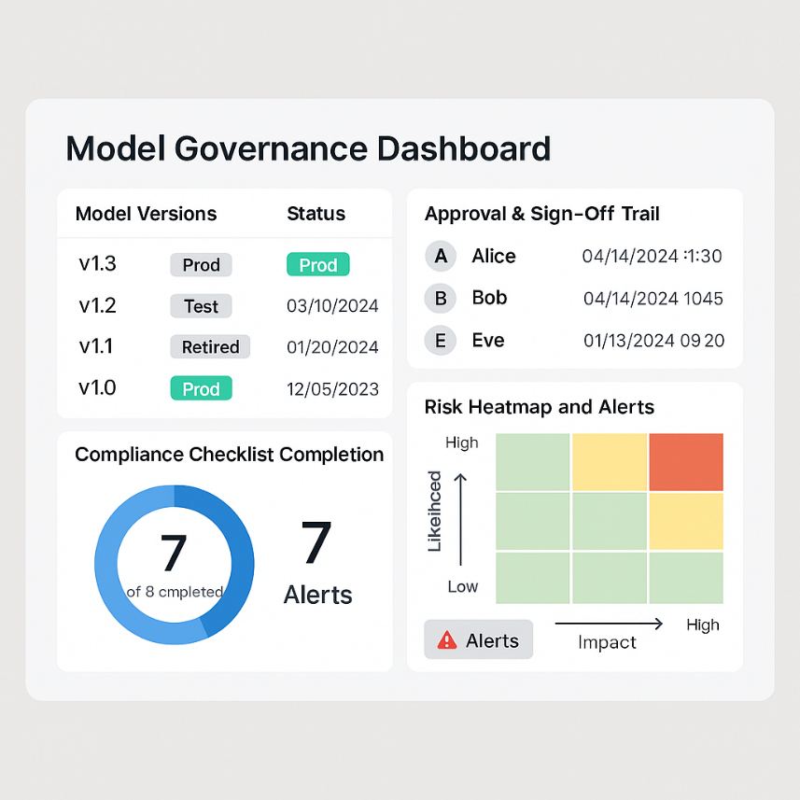
Sample Dashboard and Challenges
Model Governance Dashboard Example
Model versions, status (prod/test/retired)
Approval & sign-off trail
Compliance checklist completion
Risk heatmap and alerts
Common Governance Challenges
Lack of centralized control
Inconsistent documentation and metadata
Shadow models or rogue deployments
Difficulty in maintaining compliance at scale

Slide 7
Summary
Model Governance ensures ML systems are secure, auditable, and compliant.
It’s a critical part of MLOps maturity.
Governed models are reliable, ethical, and business-aligned.

